Slide 1

FEMA
More robust tool
Used in engineering and industrial systems, but applicable across a wide range

Slide 2
Risk Management and Reporting Tools

Slide 3
FEMA / FMECA
Failure Modes and Effects Analysis (FEMA) or Failure Modes, Effects and Criticality Analysis (FMECA)
Methodologies designed to identify potential failure modes for a product or process, to assess the risk associated with those failure modes, to rank the issues in terms of importance and to identify and carry out corrective actions to address the most serious concerns.

Slide 4
Information
Requires gathering this information
Items(s)
Function(s)
Failure(s)
Effects(s) of Failure
Causes(s) of Failure
Current Control(s)
Recommended Action(s)
Other Relevant details

Slide 5
Basic Questions of FMEA
Why failures will happen (Failure mode)?
What is the consequence when the failure occurs (Failure effect)?
Is the failure in the safe or danger direction (Failure Criticality)?
How to remove the failure or reduce its frequency?

Slide 6
Benefits of FMEA
FMEA is one of the most important and most widely used tools of reliability analysis.
The FMEA facilitates identification of potential design reliability problems
  Identify possible failure modes and their effects
  Determine severity of each failure effect
FMEA helps
  removing causes of failures
  developing systems that can mitigate the effects of failures.
  to prioritize and focus on high-risk failures

Slide 7
Benefits of FMEA
It provides detailed insight about the systems interrelationships and potentials of failures.
Information gained by performing FMEA can be used as a basis for
  troubleshooting activities
  maintenance manual development
  design of effective built-in test techniques.

Slide 8
The results of the FMEA
Rank each failure mode.
Highlight single point failures requiring corrective action
Identify reliability and safety critical components

Slide 9

FMEA Techniques
The FMEA can be implemented using a hardware (bottom-up) or functional (top-down) approach
Due to system complexity, it isperformed as a combination of the two methods.

Slide 10

FMEA Techniques
Hardware Approach :
  The bottom-up approach is used when a system design has been decided already.
  Each component in the system on the lowest level is studied one-byone.
  Evaluates risks that the component incorrectly implements its functional specification.

Slide 11

FMEA Techniques
Functional Approach :
  Considers the function of each item. Each function can be classified and described in terms of having any number of associated output failure modes.
  The functional method is used when hardware items cannot uniquely identified
  This method should be applied to when the design process has developed a functional block diagram of the system, but not yet identified specific hardware to be used.

Slide 12

FMEA Prerequisites
Define the system to be analyzed
  System boundaries.
  Main system missions and functions.
  Operational or/and environmental conditions.
Collect available information that describes the system functions to be analyzed.
Collect necessary information about previous and similar designs.

Slide 13

Analysis Procedure
Assemble the team
Establish ground rules
Gather and review relevant information
Identified the item(s) or process(es) to be analyzed
Identify the function(s), failure(s), effect(s), cause(s) and control(s) for each item or process to be analyzed.
Evaluate the risk associated with the issues identified by the analysis
Prioritize and assign corrective actions
Perform corrective actions and re-evaluate risk
Distribute, review and update the analysis

Slide 14
Functional Block Diagram
Functional block diagram shows how the different parts of the system interact with each other.
It is recommended
  to break the system down to different levels.
  to review schematics of the system to show how different parts interface with one another by their critical support systems to understand the normal functional flow requirements.
  to list all functions of the equipment before examining the potential failure modes of each of those functions.
  to include operating conditions (such as; temperature, loads, and pressure), and environmental conditions in the components list.

Slide 15
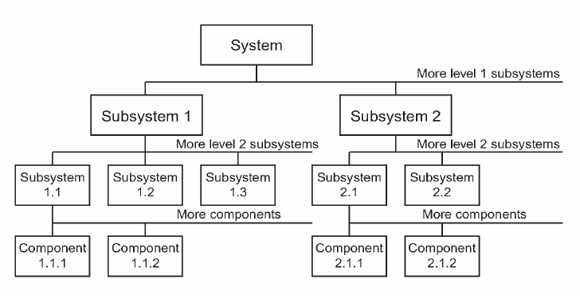
Functional Block Diagram

Slide 16
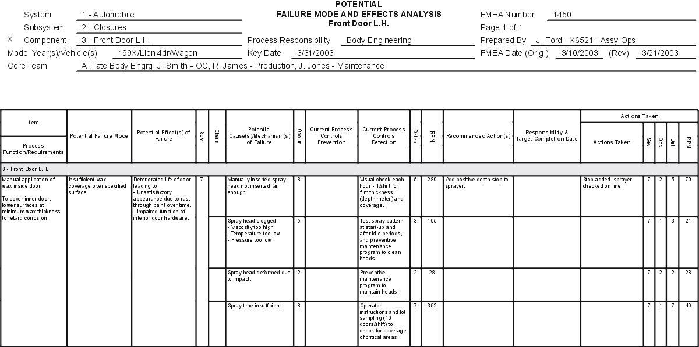
optr
Process FMEA (PFMEA) in the Automotive Industry Action Group (AIAG) FMEA-3 format.

Slide 17

Quantifying Risk
Basis for FEMA as well as other risk assessment quantitative methods.
Project Managers often use subjective methods … rules of thumb.
With complex projects it is critical to quantify risk as much as possible.
Quantification methods can be simple…or very complex.
Slide 17
Notes:
17
Rules of thumb may work very well on small and even medium sized projects.
But they are not workable for most large projects.
10% of a $1 billion project is $100,000,000. Enough to build large chunks of the original project, perhaps starting over from scratch.

Slide 18

Risk Analysis
Risk Priority Numbers
Criticality Analysis

Slide 19
Scoring Methods
Simple Binary
Issue | Qualifies | Does Not Qualify
No increase in energy requirements | x
Potential Market size, income | x
No new facility required | x
No new technical expertise required |  | x
Quality of product can be maintained | x
Project can be managed with current personnel |  | x
No requirement for reorganization | x
No impact on safety | x
Annual profits estimated at $250,000 or greater | x
Net Present value positive | x
No need for external consultants |  | x
Consistent with current line of business | x
Impact on company image positive | x

Slide 20
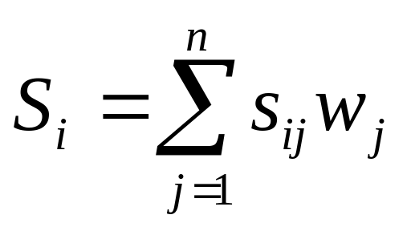
The Weighted Scoring Model
where
S_{i} = the total score of the i^{th} project
s_{ij} = the score of the i^{th} project on the j^{th} criterion
w_{j} = the weight or importance of the j^{th} criterion

Slide 21

Risk Priority Number or PDM
Rate the Severity or magnitude of each effect of failure
Rate the likelihood or probability of occurrence for each cause of failure
Rate the likelihood of prior detection for each cause of failure (i.e. the likelihood of detecting the problem before it reaches the end user or customer)
Calculate the PDM by obtaining the product.
This is called RPN in FEMA terminology

Slide 22
PDM
PDM= Probability of Occurence X Probability of Detection X Magnitude
The PDM can then be used to compare issues within the analysis and prioritize for corrective action
We will use an enhanced Risk Probability metric in a bit.

Slide 23
Risk Modeling or PDM
Probability that failure will occur (P)
Probability that the failure can be detected in sufficient time (D)
Magnitude of the failure (M)
Risk Probability (R) = P x (1-D) x M x 100
Slide 23
Notes:
23
A simple numeric risk model

Slide 24
Probability of Occurrence
Probability of Occurrence | Value | Decimal
Remote (Occurrence unlikely) | 1 in 1,000,000 | .000001
Low | 1 in 20,000 | .00005
Low to Medium | 1 in 4,000 | .00025
Medium (Occasional failures) | 1 in 1,000 | .001
Medium to High | 1 in 400 | .0025
High (Repeated failures) | 1 in 40 | .025
Very High (Highly Likely) | 1 in 2 | .500
Slide 24
Notes:
24

Slide 25
Probability of Detection
Probability of Detection | Value
Remote (Detection impossible) | Less than 1%
Very Low (Detection unlikely) | 1% to 10%
Low | 10% to 30%
Medium (Detection possible) | 30% to 50%
Medium to High | 50% to 70%
High (Good chance of detection) | 70% to 90%
Very High (Detection predictable) | 90% to 100%
Slide 25
Notes:
25

Slide 26
Magnitude of Effect(Severity)
Magnitude | Value
Minor (No measurable effect) | 1
Low (slight effect only) | 2 or 3
Moderate (Customer will experience some dissatisfaction) | 4 to 6
High (High degree of dissatisfaction probable) | 7 to 8
Very High (Failure of the project) | 9 to 10
Slide 26
Notes:
26

Slide 27
Sample Risk Levels
Risk | P | D | M | R
Supplier fails to deliver on time | .500 | .25 | 9 | 337.5
Product fails reliability testing | .0025 | .10 | 6 | 1.35
Product design proves untenable | .0001 | .70 | 10 | .03
Product marketing not ready on time | .0010 | .80 | 3 | .06
Production capacity insufficient | .500 | .20 | 9 | 360
Risk Probability (R) = P x (1-D) x M x 100
Slide 27
Notes:
27
The numbers calculated give us an easy method to see where we need to put our risk reduction emphasis

Slide 28
Risk Management
Risk | Level | Action Plan | Assigned
Supplier fails to deliver on time | 337.5 | Find a New Source | Buyer
Product fails reliability testing | 1.35 | Monitor Weekly; redesign if needed | Design Team
Product design proves untenable | .03 | Monitor Weekly: redesign if needed | Design Team
Product marketing not ready on time | .06 | Monitor Monthly | Marketing
Production capacity insufficient | 360 | Monitor Weekly; re-plan as needed | Manufacturing
Slide 28
Notes:
28
We not only need to identify risks and evaluate them, but also develop a contingency plan and assign someone to carry it out.

Slide 29

Risk Tool
Use the basic Risk Quantification tool in small groups.

Slide 30
Risk Register
Risk Identification |  |  |  |  |  |  | Risk Analysis |  |  |  | Response Planning |  |  | Risk Monitoring and Control
CATEGORY | RISK | Trigger Point | Potential Outcome | Raised By | Date Raised | Source | Probability | Probability of Detection | Magnitude | Score | Risk Strategy | Response Notes/Plan | Owner | Status | Trigger Date | Notes
Planning
Scope
DESIGN
TECHNICAL
POLITICS
PROJECT MANAGEMENT
CONTRACTS
STANDARDS
TEAM
CHANGE CONTROL
COMPETITOR
CLIENT ACCEPTANCE

Slide 31

Criticality Analysis
-Quantitative Risk Assessment
Simple Method: Cost x impact
FEMA Method:
  Can assess based on simple method
  Focused on specific items, especially in manufacturing.

Slide 32
Criticality: Simple Method
+
Criticality
Cost of Risk
Impact of Risk
+

Slide 33
Item Criticality
Calculate the criticality for each item by obtaining the sum of the criticalities for each failure mode that has been identified for the item.
Item Criticality = SUM of Mode Criticalities

Slide 34
Criticality
To use the criticality analysis method to evaluate risk and prioritize corrective actions, the analysis team must:
Rate the severity of the potential effects of failure.
Rate the likelihood of occurrence for each potential failure mode.
Compare cost impacts

Slide 35
Using Decision Trees
A method for drawing distinctions for risk and criticality and other issues.
Decision Box on Left
From box draw tree to right with branches to each alternative you can imagine
At the end of each line draw a circle if the decision is uncertain. Draw a box if this leads to new decisions. Write the decision or factor above the circle or box.

Slide 36
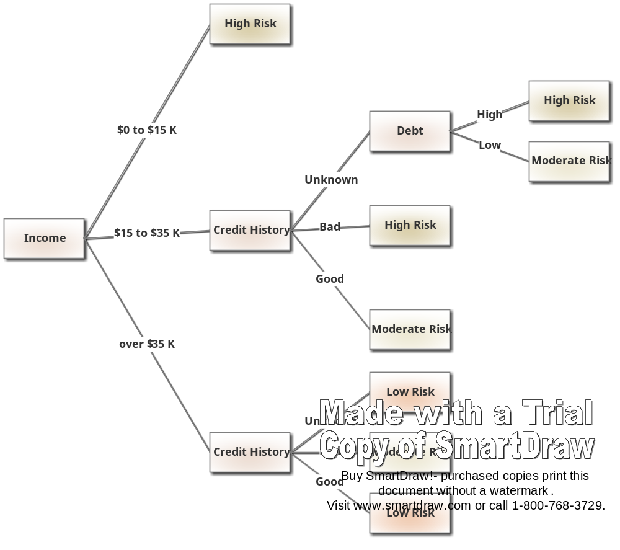
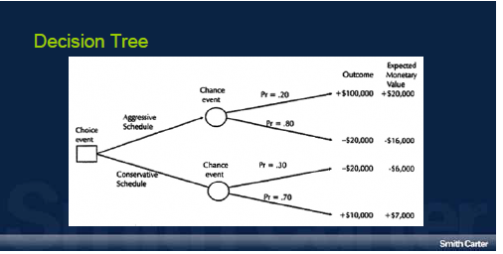

Slide 37
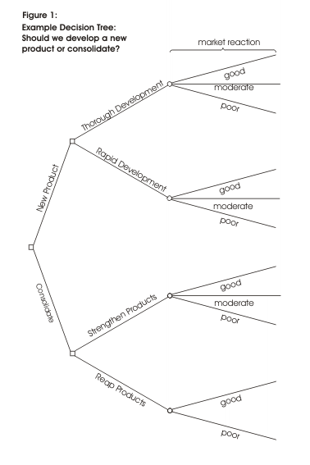

Slide 38
Monetary Value
-Quantitative Risk Assessment
A final addition to the FEMA sheet can be monetary value of risks and benefits
FEMA sheet used to capture risks, then a further sheet can be used to capture risks and benefits
Shows expected monetary value.

Slide 39
EMV
Risk | Probability | Cost Impact | Expected Monetary Value
10 | 50% | $39000 | $19500
11 | 30% | $66000 | $19800
12 | 15% | $5000 | $750
14 | 25% | $8000 | $2000
15 | 40% | $10000 | $4000
29 | 10% | $(22000) | $(2200)
Expected Monetary Value of Risks and Benefits |  |  | $43850

Slide 40
FMEA / FMECA
You can use something as simple as a paper form or an Excel spreadsheet to record your FMEA / FMECA analyses. However, if you want to establish consistency among your organization's FMEAs, build a "knowledge base" of lessons learned from past FMEAs, generate other types of reports for FMEA data (e.g. Top 10 Failure Modes by PDM, Actions by Due Date, critcatality, highest cost risks etc.) and/or track the progress and completion of recommended actions, you may want to use a software tool, such as ReliaSoft's Xfmea, to facilitate analysis, data management and reporting for your failure modes and effects analyses.

Slide 41
FEMA TOOL
Use the FEMA template in small groups.

Slide 42
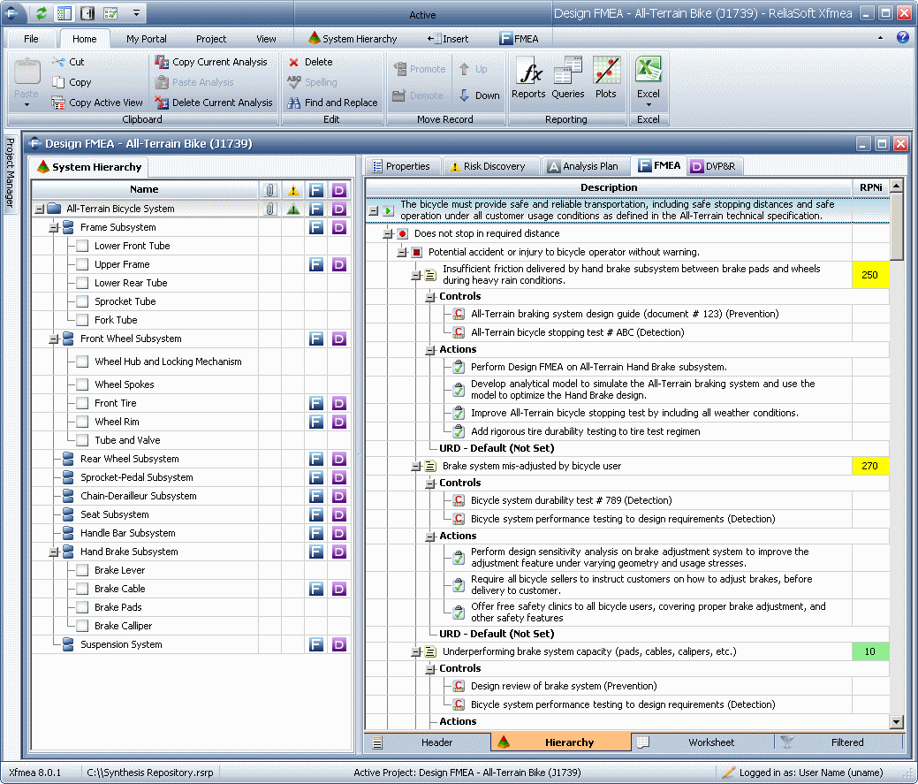

Slide 43
Risk Monitoring and Control
Manage Risk Through:
  Contingency planning
  Situational analysis and alternative analysis
  Comprehensive analysis of the drivers behind courses of action
  Pro and con analysis of alternative(s) selected
  Quantifying the decision process
  Using parallel solutions in cases of high risk
Slide 43
Notes:
43
DOD experience:
Global Broadcast System Program – high speed data and video capability world wide…
Numerous failures, tried to bring in all functionality at once.
Changed to spiral development method with one year increments, each broken into 6 month efforts, 6 sigma approach with critical chain development….
The risk process must be integrated with cost, schedule and performance processes with baselines and measures to monitor the overall program. The process needs to influence the approaches used to achieve success, such as having alternative design teams where you have uncertain design issues. A simple measure of a project in process is to identify how many issues biting the project team were identified risks. If less than 50%, your methodology is crisis driven rather than structured.

Slide 44
Confronting Uncertainty
In addition to examining risks from the perspective of quantification, we should also examine risks to see where assumptions should be clarified.
Some assumptions are quantifiable and we can test the assumptions using tools such as Monte Carlo.
The following example uses Crystal Ball

Slide 45
Confronting Uncertainty
Consider the previous NPV analysis which showed a positive NPV.
  Assume that the costs are associated with a fixed contract so those are fixed.
  The inflows are based on assumptions, so we can test those assumptions with a Monte Carlo analysis.
  We also want to test our inflation assumptions.

Slide 46
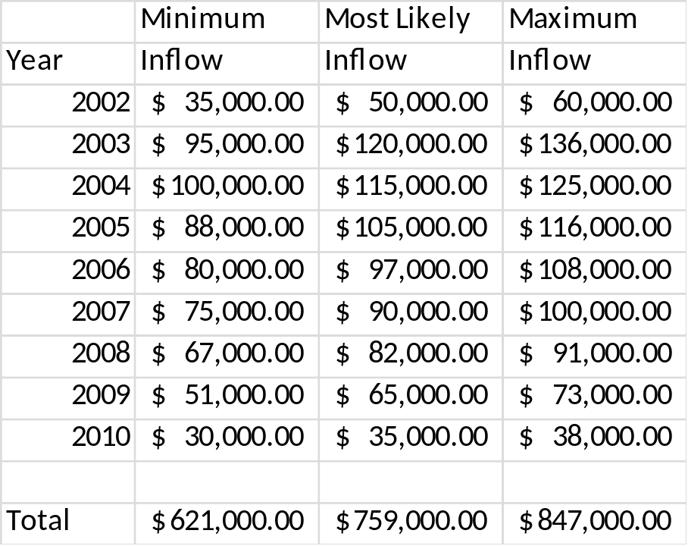
LOP Inflow Assumptions
Inflation assumption is 2% plus or minus 1%

Slide 47
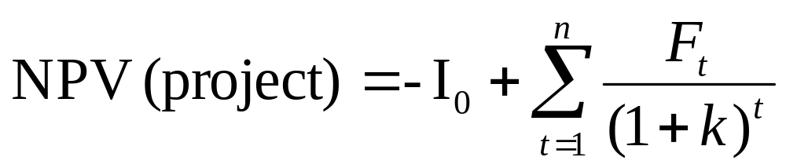
Discounted Cash Flow
where
I₀ = the initial investment
F_{t} = the net cash flow in period t
k = the required rate of return or hurdle rate

Slide 48
Net Present Value
 |  |  |  | Discount | Net Present
Year | Inflow | Outflow | Net Flow | Factor | Value | p | k | t
A | B | C | D=(B-C) | 1/(1+k+p)^{t} | DX(Disc Factor) | 0.02 | 0.13 | 0
2000* | $0 | $125,000 | ($125,000) | 1.0000 | ($125,000) | 0.02 | 0.13 | 0
2000 | 0 | 100000 | ($100,000) | 0.8696 | ($86,957) | 0.02 | 0.13 | 1
2001 | 0 | 90000 | ($90,000) | 0.7561 | ($68,053) | 0.02 | 0.13 | 2
2002 | 50000 | 0 | $50,000 | 0.6575 | $32,876 | 0.02 | 0.13 | 3
2003 | 120000 | 15000 | $105,000 | 0.5718 | $60,034 | 0.02 | 0.13 | 4
2004 | 115000 | 0 | $115,000 | 0.4972 | $57,175 | 0.02 | 0.13 | 5
2005 | 105000 | 15000 | $90,000 | 0.4323 | $38,909 | 0.02 | 0.13 | 6
2006 | 97000 | 0 | $97,000 | 0.3759 | $36,466 | 0.02 | 0.13 | 7
2007 | 90000 | 15000 | $75,000 | 0.3269 | $24,518 | 0.02 | 0.13 | 8
2008 | 82000 | 0 | $82,000 | 0.2843 | $23,310 | 0.02 | 0.13 | 9
2009 | 65000 | 0 | $65,000 | 0.2472 | $16,067 | 0.02 | 0.13 | 10
2009 | 35000 |  | $35,000 | 0.2472 | $8,651 | 0.02 | 0.13 | 10
Total | $759,000 | $360,000 | $399,000 |  | $17,997

Slide 49
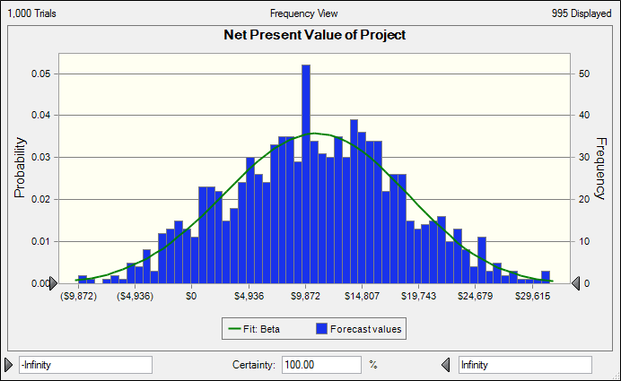
Testing the NPV Assumptions

Slide 50
NPV Statistics
Forecast: Net Present Value of Project
Statistic Fit: Beta Forecast values
Trials '--- 1,000
Base Case '--- $17,997
Mean $10,631 $10,631
Median $10,702 $10,615
Mode $10,855 '---
Standard Deviation $7,551 $7,555
Variance $57,017,081 $57,074,155
Skewness -0.0520 -0.0519
Kurtosis 2.82 2.82
Coeff. of Variability 0.7103 0.7106
Minimum ($34,951) ($14,694)
Maximum $49,858 $32,564
Mean Std. Error '--- $239

Slide 51
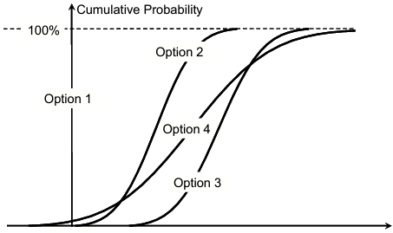
Example of Project Option Decision
Net Present Value - $
Notes:
Information on overall project risk can be useful for a number of project strategy decisions, including: Project approval (go/no go decisions), setting targets and estimating contingencies, and choosing between project options. A project sponsor might deem a project unacceptable if the overall level of risk was too high. A typical approach would be to consider whether or not the 90th percentile confidence outcome would be acceptable. Assuming the project was approved, the sponsor could then choose to set the project manager a target of achieving a much better outcome than this, but nevertheless allocate contingencies to provide sufficient confidence that the outcome would be acceptable. Providing a realistic basis for distinguishing between project targets, expected outcomes and commitments is an important contribution that the risk management process can make. Project strategy decisions can also involve choosing between different project solutions. Typically such strategic choices are taken during the earliest project phases. Example illustrates how an analysis of overall project risk can help to resolve a strategy choice.
Example – a project strategy decision a s a consequence of a recent merger, a retail company has two major distribution centres, a and B. i n order to realise some of the value added by the merger, it initiates a project to rationalise these to a single centre. during the concept phase, four options are studied: 1. Retaining the two existing centres, 2.transferring all operations to a , 3. transferring all operations to B, and 4. establishing a new enhanced distribution centre and closing both a and B
.
Option 1 is to continue with the status quo. i t is included in the concept phase risk analysis to provide a baseline against which the other options can be compared. Options 2 and 3 both involve risks attributable to factors such as the implications of expansion at the chosen site and the price that might be obtained by selling the other site. Option 4 is the highest cost and has the greatest level of risk. However, its potential benefits are greater since neither of the existing distribution centres are optimally located for the merged business. During the concept phase the project team makes high level estimates of the risks involved with Options 2 to 4, taking into account the effects of risk on cost, economic benefits and timescale. This allows them to develop an assessment of the overall risk to the Net Present value (NP v ) associated with each option. The results produced by this analysis are shown. The s-curves in Figure show the potential range of NP v associated with each option. Note that, since a positive NPV is beneficial, points on the curves towards the right indicate better outcomes than points towards the left. The s-curve for option 4 shows that it is potentially the best option since the right most extent of the curve is better than any other option. However, the curves also confirm that Option 4 has the highest risk, since its range of possible outcomes is relatively broad. The fact that the curve reaches in to negative N v P also suggests that option 4 might even destroy value (that is, its costs could outweigh its benefits). In comparison, Options 2 and 3 are always beneficial choices compared to the baseline. But, most importantly, the position at which the options 3 and curves cross shows that option 3 is the more likely to produce the higher NP v . i n effect, the project team has calculated that, although option 4 is potentially attractive, risks associated with buying the land, obtaining planning permission and ramping up a brand new facility mean that, on average, transferring operations to distribution centre B is a better choice. Based on these insights, the project sponsor instructs the project team to use the project definition phase to develop detailed plans for o ption3. However, in the meantime, the sponsor also launches a market survey of existing facilities in case an opportunity for a better version of option 4 should present itself.

Slide 52
Risk Metrics
More in-depth risk analysis combines the use of a spreadsheet with metrics in a manner similar to the following:
  Risk Metrics
With sufficiently developed metrics, use of this approach becomes a major improvement of your corporate Strategic PM process

Slide 53
Risk Metrics
Use current metrics plus history to more accurately define and estimate project and program risk
Using this approach moves your organization toward maturity Level 4 of Risk Maturity
You can more confidently say which projects are likely to succeed, as well as make better estimates of projects, programs, and risks

Slide 54
More Complex Methods: Example
Software Risk Management Methods are often fairly complex:
  Size, Technology, Process
  Multiple questions for each area
  Weighted responses
  Compared to internal or external standards
Slide 54
Notes:
54
These methods take account of numerous variables to arrive at a reasonable risk assessment, and allow the organization to compare their project success with that of other organizations.

Slide 55
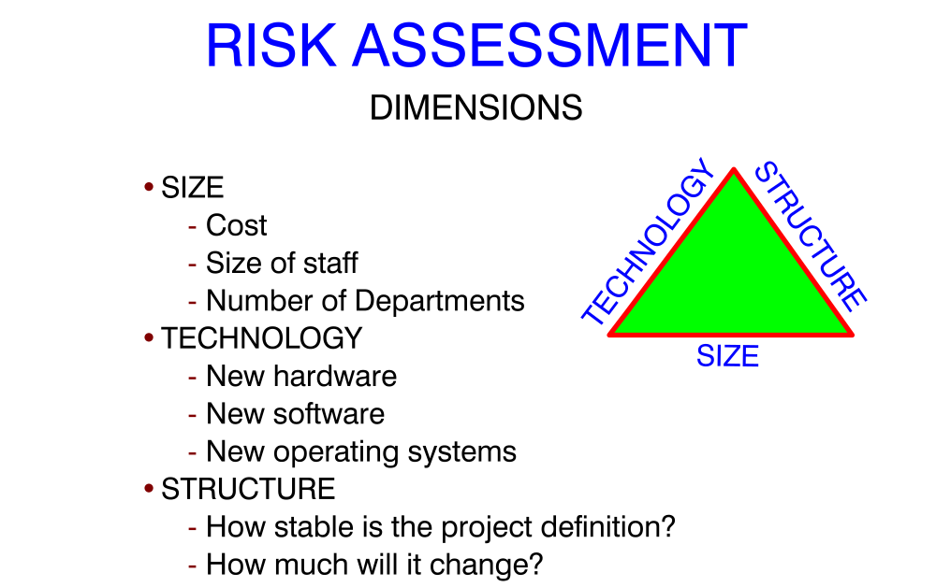

Slide 56
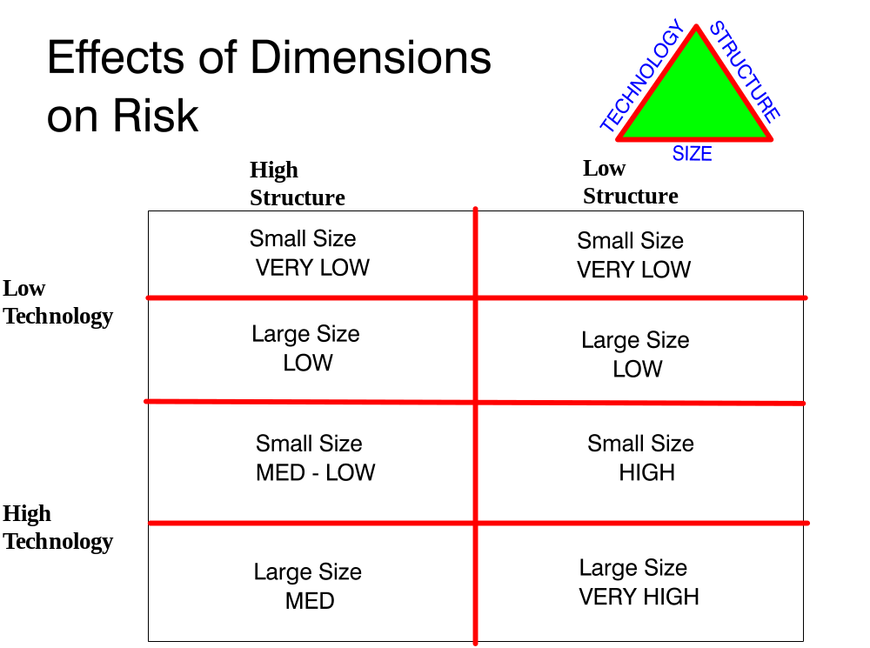

Slide 57
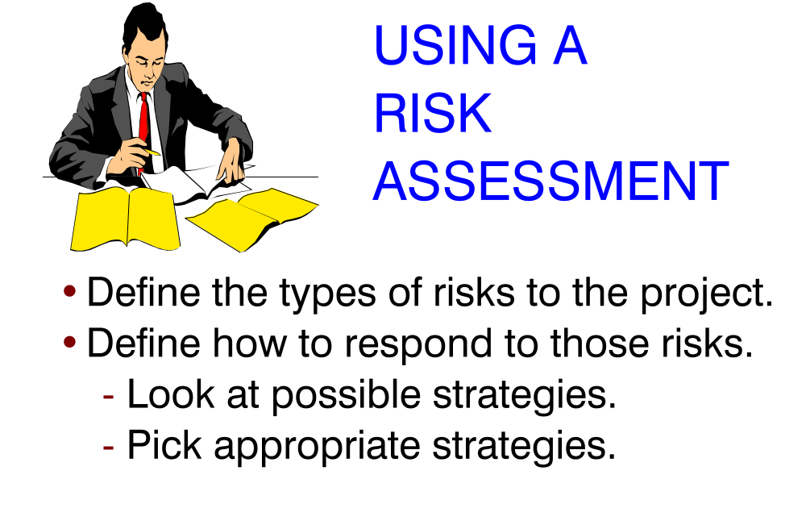

Slide 58
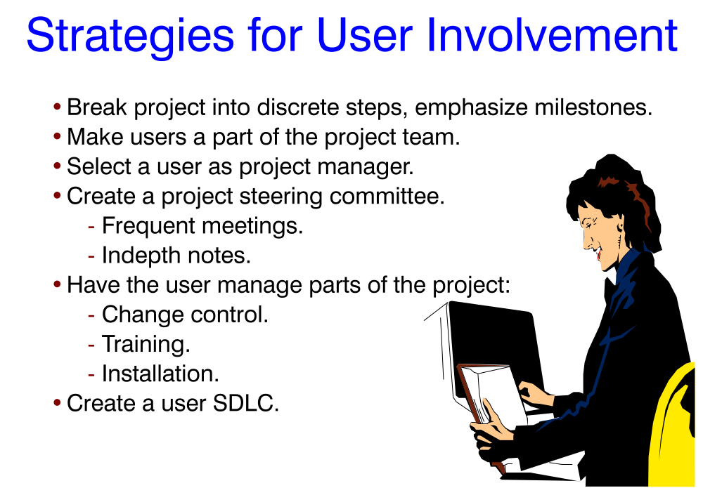

Slide 60
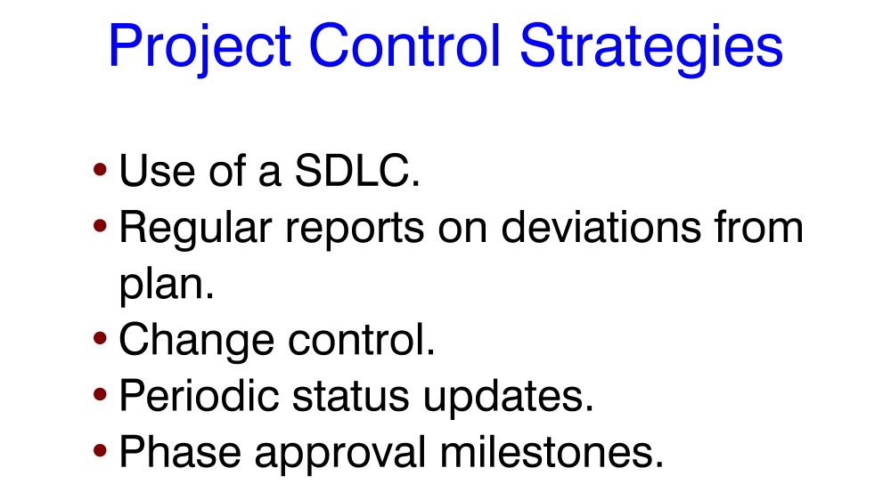

Slide 61
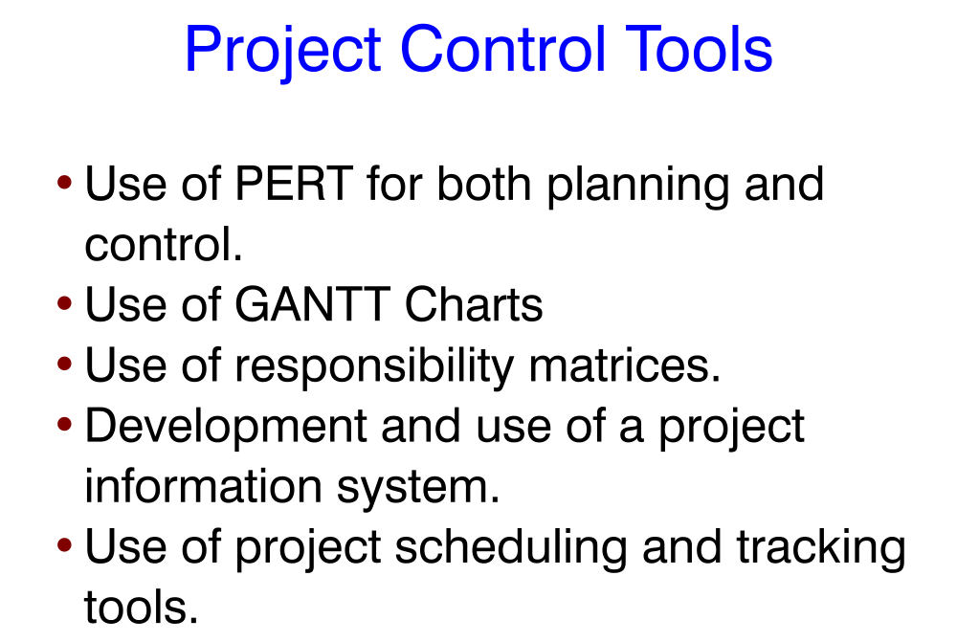

Slide 62
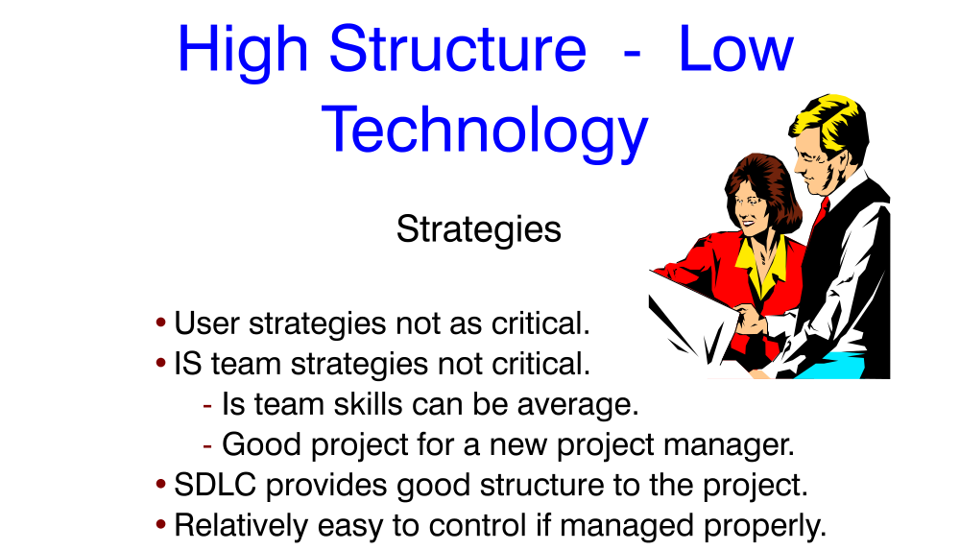

Slide 63
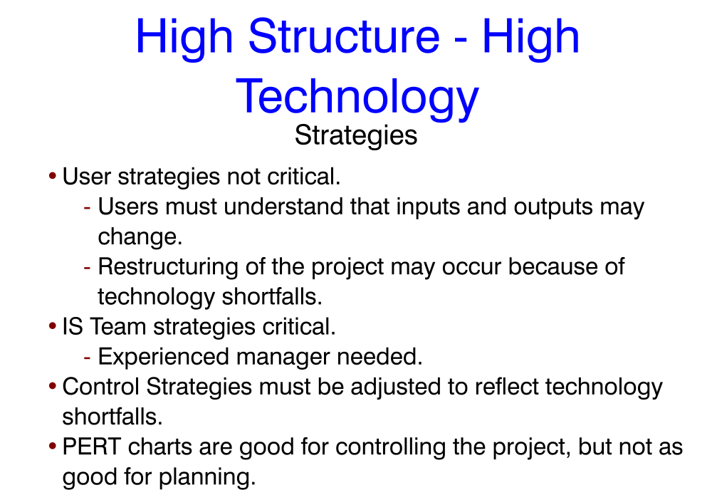

Slide 65
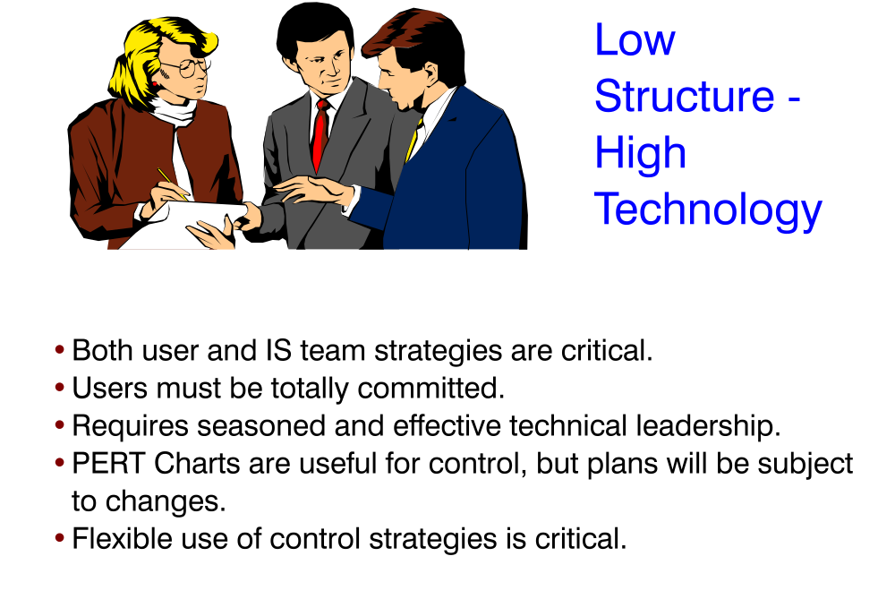

Slide 66

Program Level Risk

Slide 67

Program Level Risk
Loch, De Meyer, and Pich distinguish between project risk and project novelty (uncertainty) in their book, Managing the Unknown.
For individual projects, risk can often be clearly defined. However, in the development of new processes and new technologies, we have elements of uncertainty. We know that there will be risk, but how much risk and in what specific areas?
Slide 67
Notes:
67

Slide 68
Program Level Risk
Project risk management (PRM) is designed to deal with foreseeable risk and residual risk
Designing in flexibility is part of the planning process:
  Identify obstacles, alternative problem solving approaches, and alternative end results as part of PRM
  When an obstacle occurs, contingency plans are triggered:
    An alternative path to the desired result may be taken
      Or
    An alternative result or target may be chosen
Slide 68
Notes:
68

Slide 69
Foreseeable Risk and Residual Risk
Examples of foreseeable risk:
  New technology
    Does it work?
    Once we know the technology works, how does it work in this particular situation or application?
  New process
    What are the details?
    Will it work?
Although some of the risk can be estimated in these types of situations, not all aspects are well enough understood to accurately estimate the overall risk
Slide 69
Notes:
69

Slide 70
Foreseeable Risk and Residual Risk
In reality, an estimate is always just that – an estimate. If you knew the actual time, cost, number of resources needed, etc., you could tell clients or managers that information.
What you are usually telling them, even in a well-understood project, is your best guess.
One of the ways of dealing with guesses is to give a range, as we discussed in the Estimation section – Likely, Optimistic, Pessimistic
The individual estimates of risk can be worked into the overall project plan. This gives a range to the completion date (and project costs).
The project duration can now be displayed not with a fixed end date, but as a histogram (see the bar chart on the next slide), including a probability that the project will be completed in a certain number of days.
Slide 70
Notes:
70

Slide 71
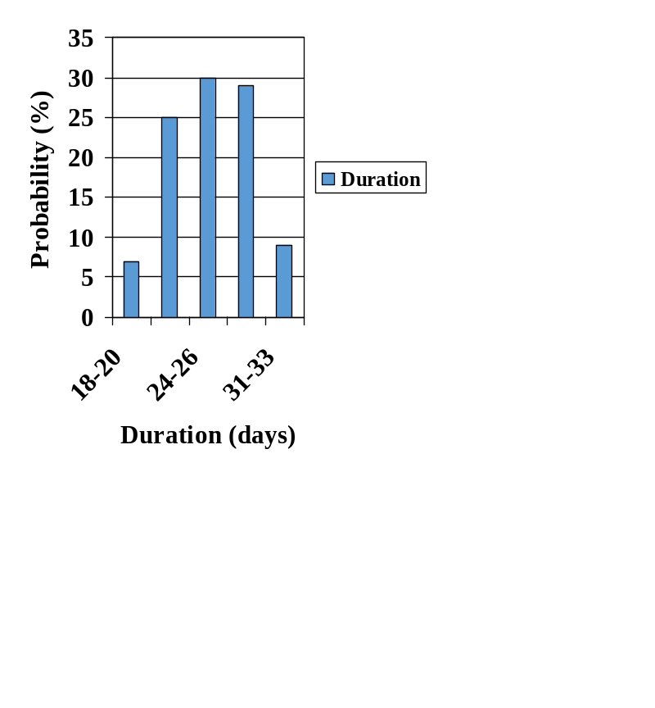
Foreseeable Risk and Residual Risk
Project Duration Histogram
  The project duration in number of days is shown at the bottom
  The probability (%) of completion within the specified number of days is on the left; there is a 7% probability the project will be completed in 18-20 days, and a 30% likelihood that it will be completed in 24-26 days, for instance
  The probability the project will be completed between 18 and 33 days is about 99%
Notes:
Look at documentation for right shifting gausian when unforseen problems arise.

Slide 72
Foreseeable Risk and Residual Risk
The preceding histogram is one way of depicting and communicating uncertainty
Another way to acknowledge variability of project estimates is to use explicit project buffers:
  Schedule buffers
  Budget contingencies
  Specification compromises
Schedule all activities at their latest possible time, based upon the project critical path; then add a buffer time at the end of the project
Another technique to keep the completion time from varying is to add buffers when one part of a project feeds another part. These “feeder” buffers keep people from concern over missed completions. They also allow earlier starts on parts of the project when tasks before the feeders complete ahead of schedule. (The overall project may still fall behind if this technique is used without careful thought, however.)
Slide 72
Notes:
72
Schedule buffer = schedule all activities at their latest start times per critical path, then add a safety buffer at the end of the project,, which protects the promised completion time from varying. If the critical path tasks finish as scheduled, then the buffer is not used; if there are problems, then part or all of the safety buffer may be used up
Feeding buffer = add a buffer whenever a non-critical path feeds into a critical path; if both the preceding critical path tasks and the non-critical path tasks finish early, then the following critical path activities can start early; if not, then the critical path will (hopefully) be minimally affected
These buffers are best moved into the project buffer per Loch et al. Task completions should be at the median (meaning they will be missed 50% of the time). The PM should monitor task completion to see how much of the buffer is being consumed against how many tasks are completed and ho much estimate time has been consumed. If all is well, nothing to do, if not, corrective action needs to be taken. The project buffer is suggested to be 50% (perhaps as low as 30%) of the individual buffers.
The idea here is that project team members don’t need to protect their individual schedules (so they are less likely to give low ball estimates of work completed), but they also can’t slack off because that will affect the overall buffer, which everyone in the project is counting on if something goes wrong.

Slide 73

Risk management and project definition
Defining project risks up front gives clients, management, and project team members a better idea what the real scope, and therefore the time and cost, of a project is likely to be.
The project team can better assess how much effort will be involved, and can therefore make a more accurate cost estimate.
Management and clients can choose which projects to focus upon, based not only upon project desirability, but also upon the likelihood that the project will complete successfully.
Slide 73
Notes:
73
Defining risk up front forces project team members and clients to take a close look at project requirements early on.
More thorough knowledge of requirements can contribute to more accurate time, resource, and cost estimates.
Which can allow management and clients to make more informed decisions

